Slide 1
Memory Management
References
  text: Tanenbaum ch.4

Slide 2
Memory Management
Functions
  protect multiple programs from interfering with one another (e.g. user vs. kernel mode execution)
  manage the address space of the processes (e.g.virtual memory)

Slide 3
User and Kernel Modes
All CPUs used for serious OS’s have at least 2 modes of execution (privilege levels or rings)
4 privilege levels for x86 processors
  0: system level (used by UNIX/Linux/Win2k kernels)
  1: unused
  2: unused
  3: user level (used by UNIX/Linux/Win2k user
  programs)
Store current privilege level in the CS(code segment) register

Slide 4
User to Kernel Mode Transitions
Via system calls
  use a system call number and the arguments
  user code executes a single instruction
Via interrupts
  use the CPU trap cycle; turn off interrupts; get a device identifier
  user code may not be aware of interrupts

Slide 5
Memory Management Approaches
Without swapping or paging
  Monoprogramming
    OS with one user process
  Multiprogramming with fixed partitions
    multiple processes run at once
    fix partition size at system start up
Swapping
Virtual memory

Slide 6

Monoprogramming
Only 1 process can run at a time

Slide 7
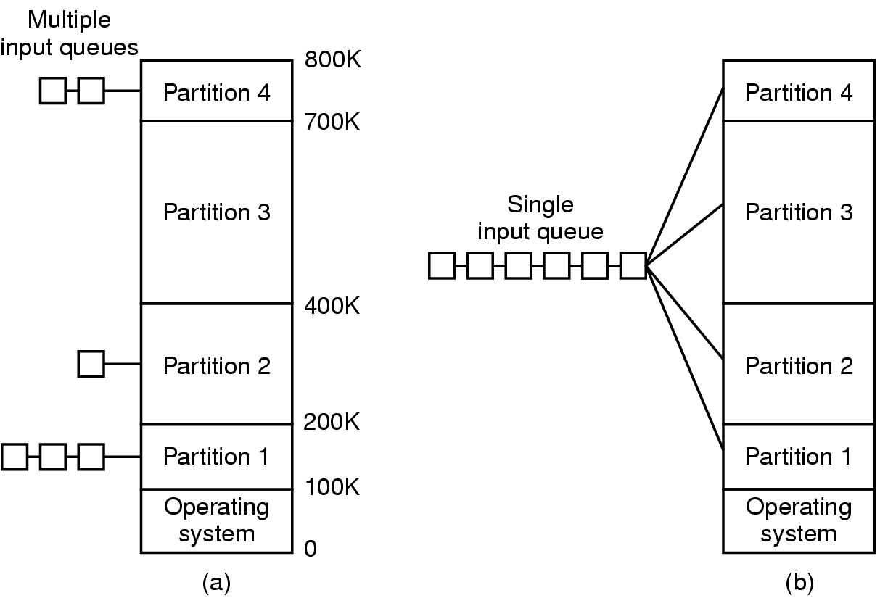
Multiprogramming w/Fixed number of Tasks (MFT)
Fixed memory partitions
  separate input queues
  single input queue

Slide 8
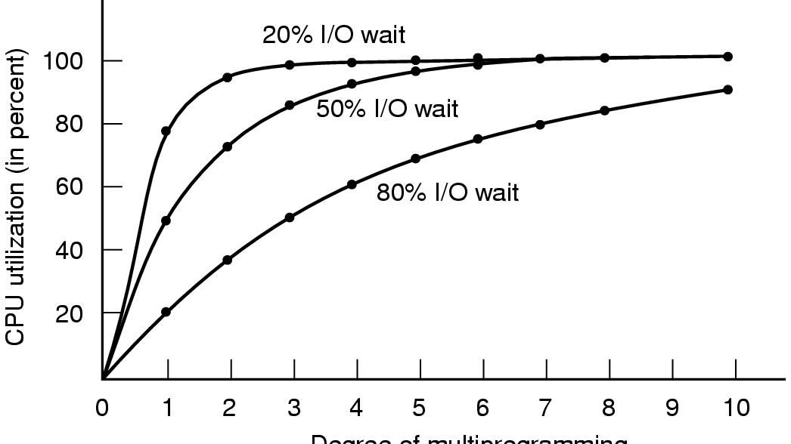
CPU Utilization
Degree of multiprogramming (# of processes in memory)

Slide 9
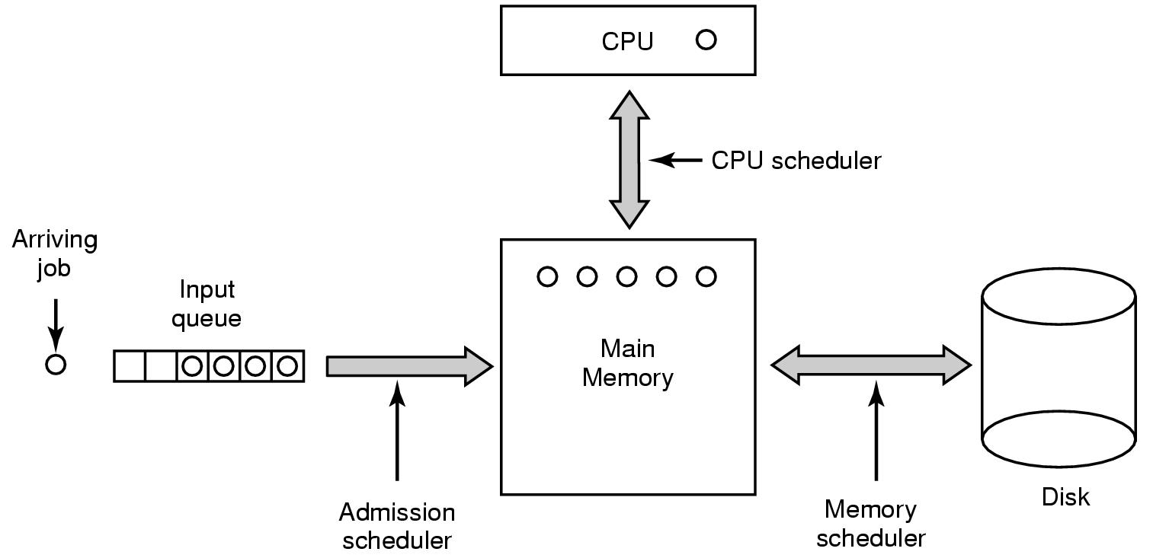
Swapping
Studied this during the scheduling lecture
memory scheduler decides which process stays in memory and which process stores on disk
can run into overload if it tries to fit too many processes in memory

Slide 10

Virtual Memory
Useful when the combined size of the program, stack, data exceeds the available physical memory
Memory Management Unit(MMU) maps virtual addresses to physical addresses
Page
table

Slide 11
Paging
Pages
  virtual address space divided into pages
  typical 4K byte size (e.g. 64K program in 16 pages)
  program extends over 1 page will take the entire additional page
Page Frames
  physical address space divided into page frames
  same size as pages (e.g. 32K memory in 8 page frames)
Page Tables
  tells which page frame is assigned to each page of the virtual address(VA)

Slide 12
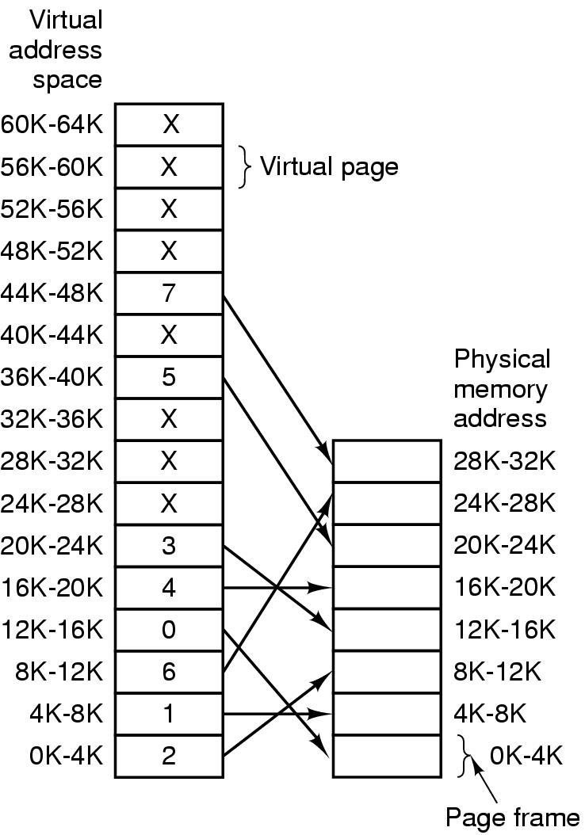
Virtual and Physical Addresses
The relation between virtual addresses and physical memory addresses given by page table
A 64KB memory (16 bits) example:
page 0 -> page frame 2
page 1 -> page frame 1
page 2 -> page frame 6
page 6 -> nothing(V bit=0)

Slide 13

Internal Operations of MMU
Specify 16-bit address and a 4-KB page size using 4 bits for virtual pages and 12 bits for offset
present bit also called
valid bit(v bit) in x86

Slide 14
Paging Examples
mov REG, 8192
Virtual addr =8192 =0x2000; start of page 2;
-> page frame 6; Physical addr 24K- 28K;
offset =0; Physical addr = 0x6000
mov REG, 8196
Virtual addr =8196 =0x2004; in page 2
-> page frame 6; Physical addr=24K- 28K;
offset =4; Physical addr = 0x6004

Slide 15

Multilevel Page Tables
32-bit address space has 1 million 4KB pages
Get around having to store huge page tables in memory all the time

Slide 16
Multilevel Paging Example
4M chunk
4K chunk
0x0040 3004 corresponds to
PT1 =0x01, PT2=0x03, offset =0x04
MMU uses PT1 to index into the top level table and PT1=1 corresponds to addresses 4M-8M
MMU uses PT2 to index into the second level table and PT2=3 points to 3x4096 to 4x4096-1 within the 4M chunk
If page is not in memory, Present/absent bit =0 and accessing the page causes a page fault
If page is in memory, present/absent bit =1 and the second page memory and offset forms the physical address

Slide 17

Typical Page Table Entry
Highly machine dependent.Typically 32-bit wide
Protection bit
  control access(r/w, or r only)
Modified(dirty) and referenced bits
  modified bit controls writing back to disk
  referenced bit indicates whether the page has been written/read or not. OS uses it to evict a page when a page fault occurs.
Caching disabled bit
  control caching of I/O ports mapped to memory

Slide 18
x86 Paging
32-bit virtual address
10 bits
10 bits
12 bits
Page Table Directory
Pointer to page table
20 bits: page addr
12 bits: ref page access and caching flags
Pointer to page table
20 bits: page addr
12 bits: ref page access and caching flags
Pointer to page table
20 bits: page addr
12 bits: ref page access and caching flags
Page Directory Entry(PDE)
20 bits: page table number
12 bits: ref page access and caching flags
0
1
1023
Page Table
Page table number n
Page table entry
20 bits: page address
12 bits: ref page access and caching flags
Page table entry
20 bits: page address
12 bits: ref page access and caching flags
Page table entry
20 bits: page address
12 bits: ref page access and caching flags
Page Table Entry(PTE)
20 bits: physical address
12 bits: cache control, page access protect
0
1
1023
32-bit physical address
Page m
20 bits
12 bits

Slide 19
x86 Paging (cont’d)
A Page Table Directory (PD) has
  1024 Page Directory Entries(PDE) which point to 1024 page tables
  each entry has 32 bits
Each Page Table(PT) has
  1024 Page Table Entries(PTE) which point to 1024 pages
  each entry has 32 bits
Each page has 4096 memory locations
Total address 1024x1024x4096= 4G

